Slide 1

Code in Place
Section 2: Art of Karel
Week 2: May 5th, 2023

Slide 2
Agenda
Check-in: how are we all doing?
Optional: concept review
Section Problem: a fun and engaging Karel problem
Bonus Problems: expanding on Karel and diving into the console

Slide 3
Before starting
How are you all doing!? Hopefully your first week of Code in Place went well!
To start off, let’s do a quick check-in question.
Choose one of the following to answer:
What’s one thing you have enjoyed or found fun about Code in Place so far?
What has been your favorite problem to work on so far?
What are you looking forward to using Python/Coding for?

Slide 4
Concept Review Questions
Are the 3 concepts below all clear? Any questions?
Decomposition
While vs. For Loop
If Statements

Slide 5

Let’s get practice some more challenging Karel problems…
Karel – Spread Beepers Problem

Slide 6
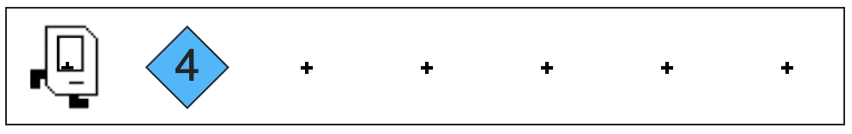
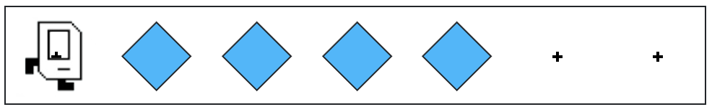
Spread Beepers
Start: We have a number of beepers which are stacked in a single pile.
Goal: We want to take these beepers and spread them out across the row.
Notice how there are still only 4 beepers in the world!!!

Slide 7

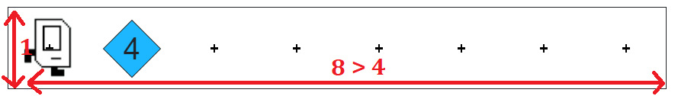
Key Problem Details
Beepers: The “catch” to this problem? Karel has infinite beepers in its bag.
World attributes: There is only one row in the world. The world is wide enough for all of the beepers.
Location: The pile of beepers is on the second column (in front of where Karel starts).

Slide 8
Bonus Problems
Karel – Spread Beepers Problem over multiple rows
Console programming

Slide 9
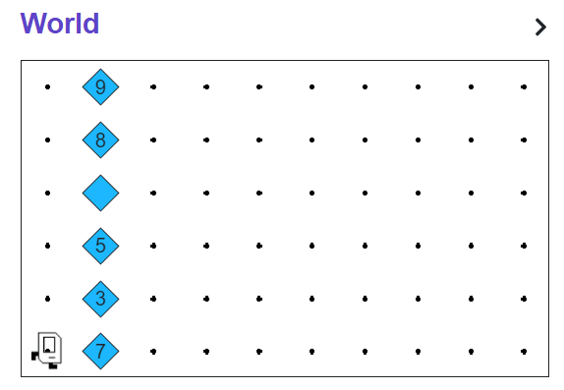
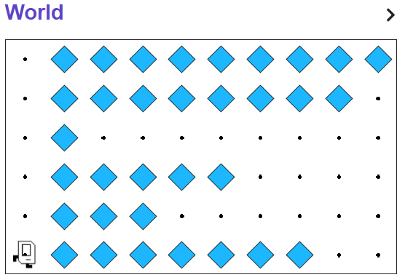
Bonus 1: Adding more rows
Problem: We have multiple rows with piles of beepers now!
Goal: We want to spread all of the rows!

Slide 10
Bonus 2: Duplicating input messages
Sample Output:
Sample input: Enter any message you’d like:
coding rocks!
coding rocks!
coding rocks!
coding rocks!
coding rocks!
coding rocks!
coding rocks!
coding rocks!
coding rocks!
coding rocks!
Enter any message you’d like: coding rocks!
* User input is italicized and bolded *

Slide 11
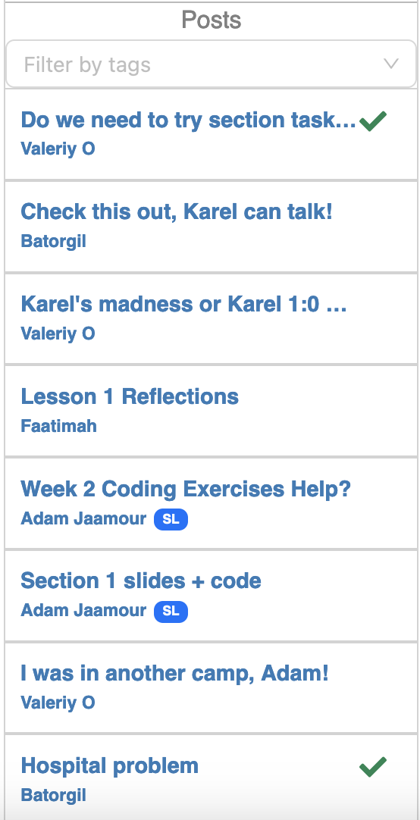
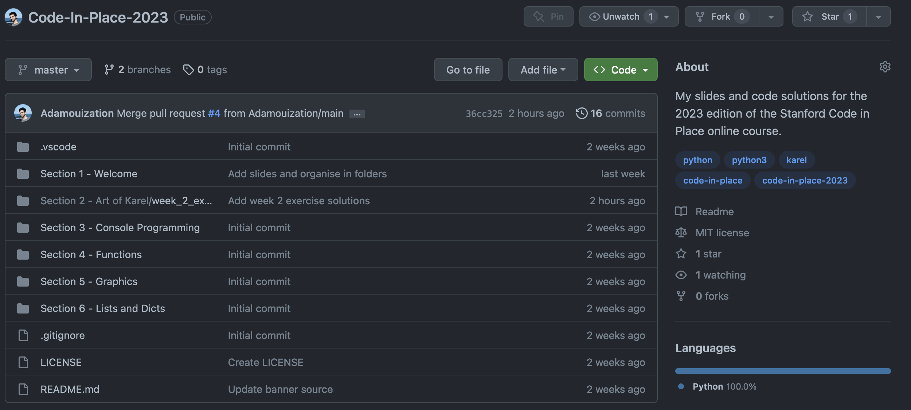
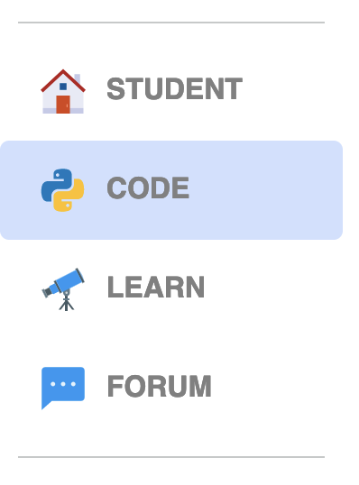
Wrap Up Announcements
Section forum: Thanks to all of you for participating in forum to share reflections, questions, show code and socialize ☺
Visit my solutions to
exercises on GitHub:
Try the extra exercises and share your code!
Something I did well, something I can do better?

Slide 12
See you next week! And on the forum
Section 2: Art of Karel
Next in Section 3: Console programming

